Slide 1
Mathematical Building Blocks for AI and DS
Dr. Shailesh Sivan
DCS, CUSAT

Slide 2
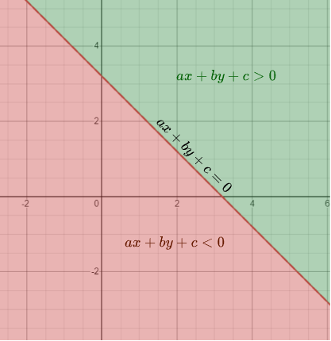
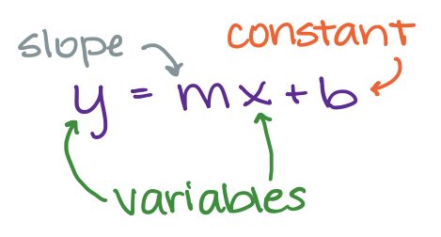
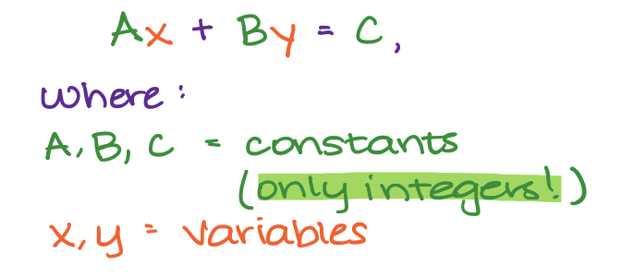
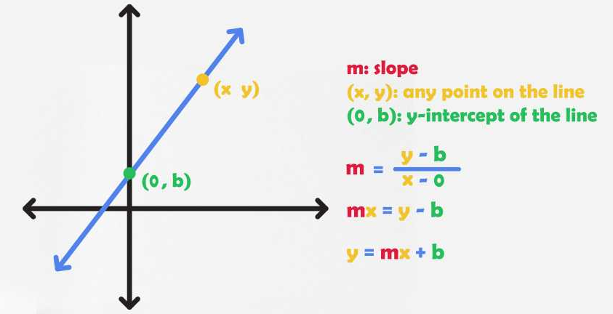
Equation of a LIne

Slide 3
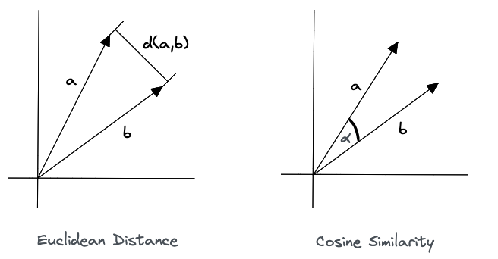
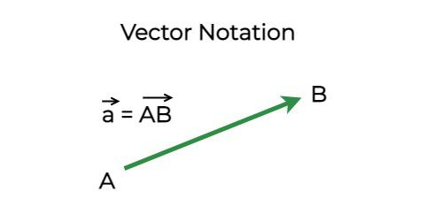
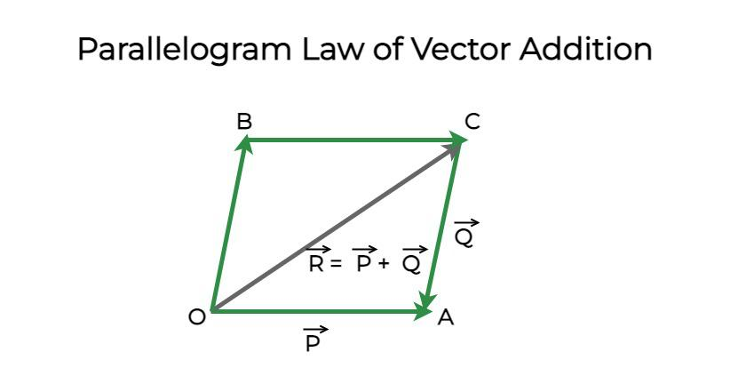
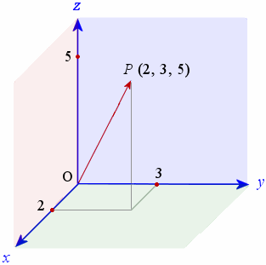
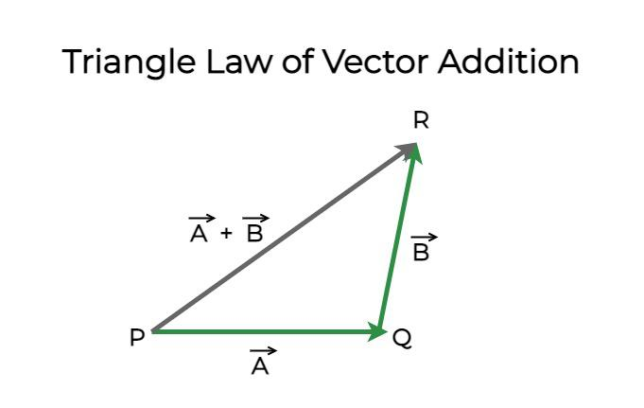
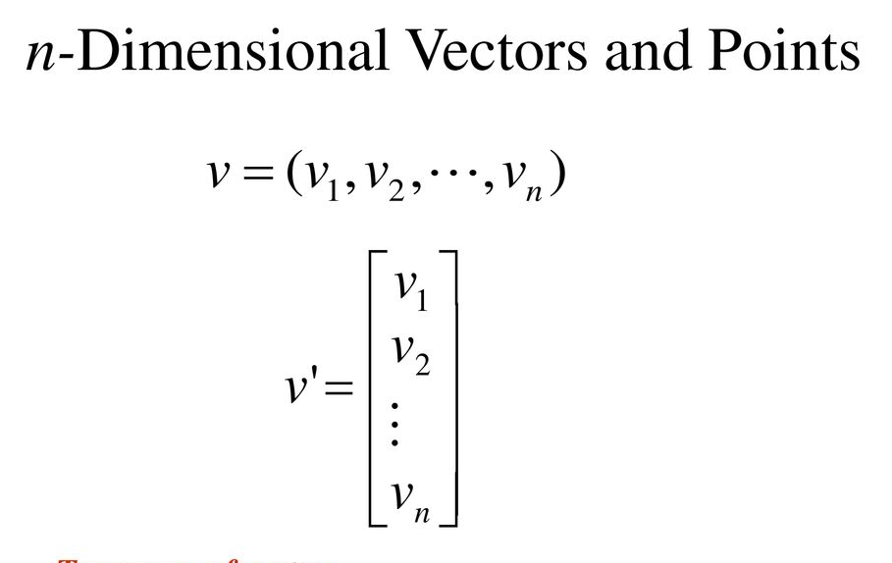
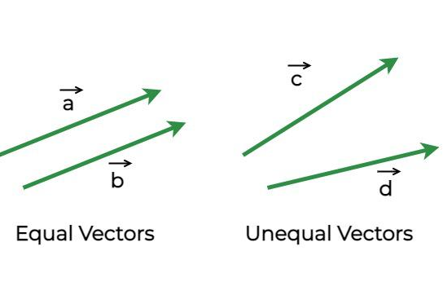
Vectors AND vectorspace
A vector is a quantity or phenomenon that has two independent properties: magnitude and direction.

Slide 4
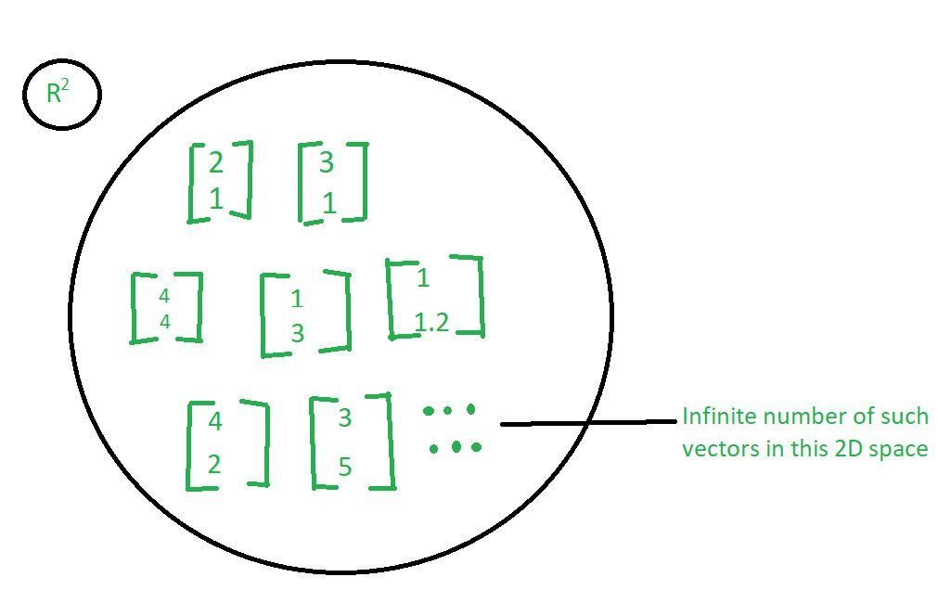
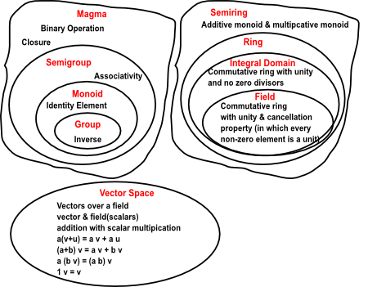
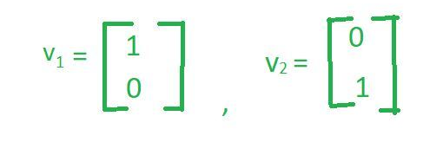
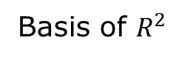
Vectors AND vectorspace
Basis of $R^{2}$

Slide 5
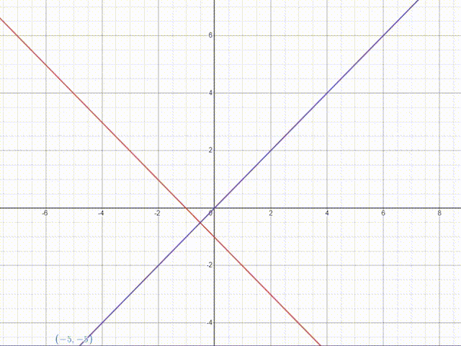
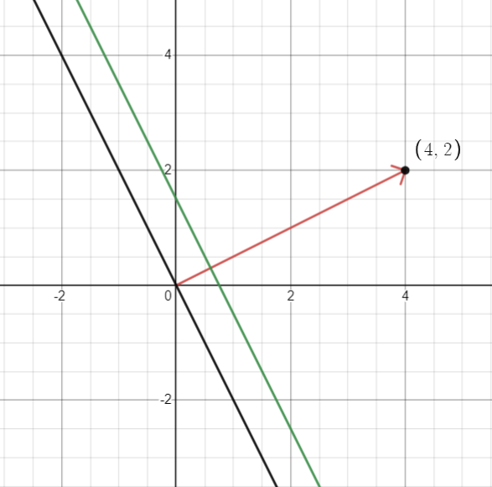
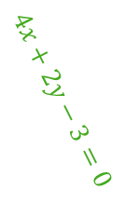
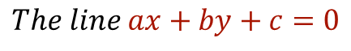
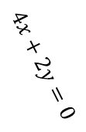
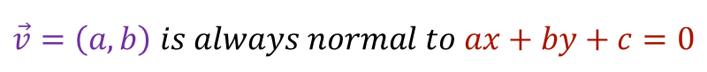
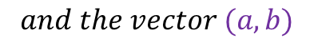
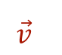
LINE AND NORMAL
$$The line ax+by+c=0$$
$$and the vector (a,b)$$
$$\vec{v}=\left(a,b\right) is always normal to ax+by+c=0$$
$$4x+2y=0$$
$$\vec{v}$$
$$4x+2y−3=0$$

Slide 6
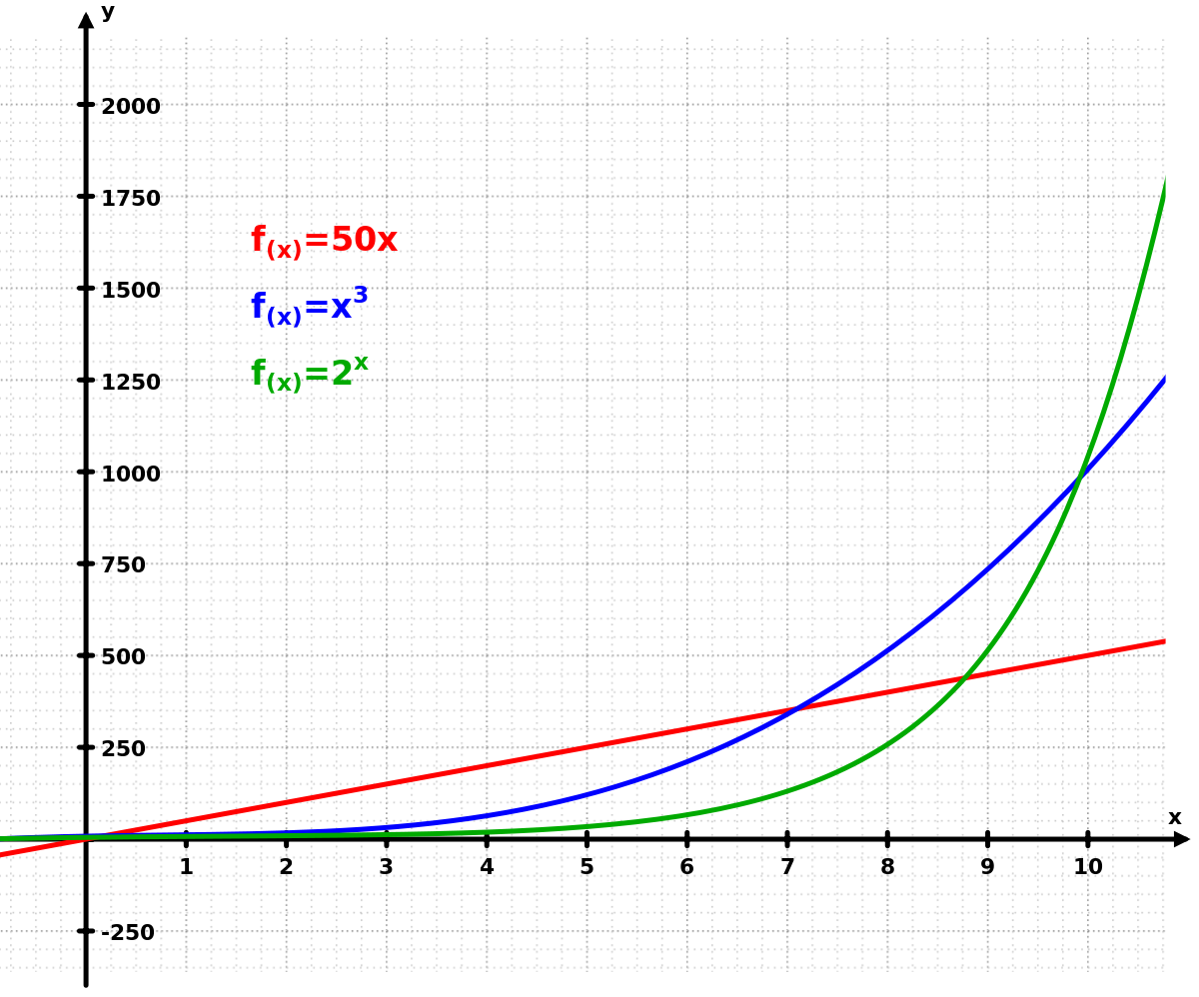
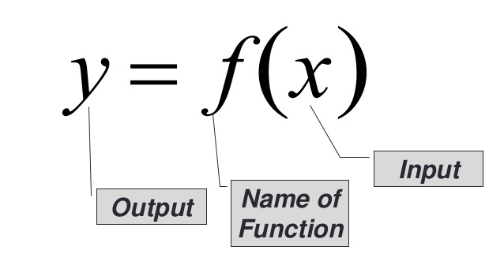
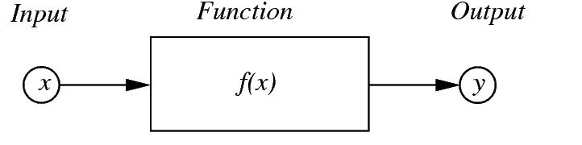
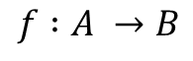
Functions
A function relates every element in a set to exactly one element in another set
$$f :A →B$$
function
domain
co-domain
A
B
range
A function which has either or one of its subsets as its range is called a real valued function. Further, if its domain is also either R or a subset of R, it is called a real function

Slide 7
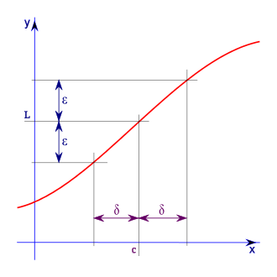
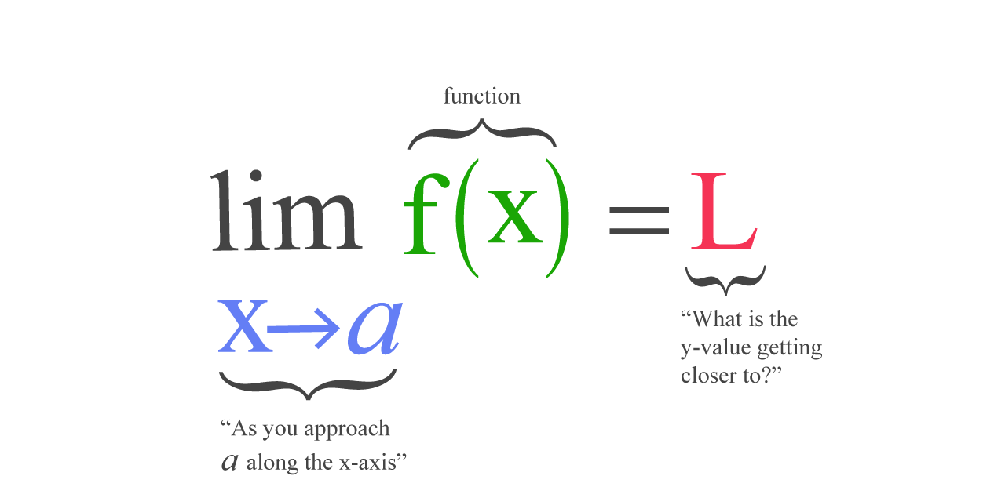
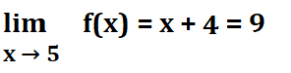
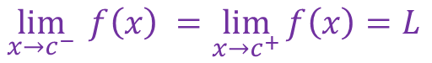
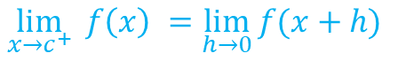
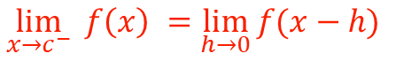
Limit of a function
The limit of a function at a point a in its domain (if it exists) is the value that the function approaches as its argument approaches a
$$\lim_{x→c^{−}}{f\left(x\right) =\lim_{h→0}{f(x−h)}⁡}$$
$$\lim_{x→c^{+}}{f\left(x\right) =\lim_{h→0}{f(x+h)}⁡}$$
Left Hand Limit
Right Hand Limit
The limit of a function exists if and only if the left-hand limit is equal to the right-hand limit.
$$\lim_{x→c^{−}}{f\left(x\right) =\lim_{x→c^{+}}{f\left(x\right)=L}⁡}$$

Slide 8
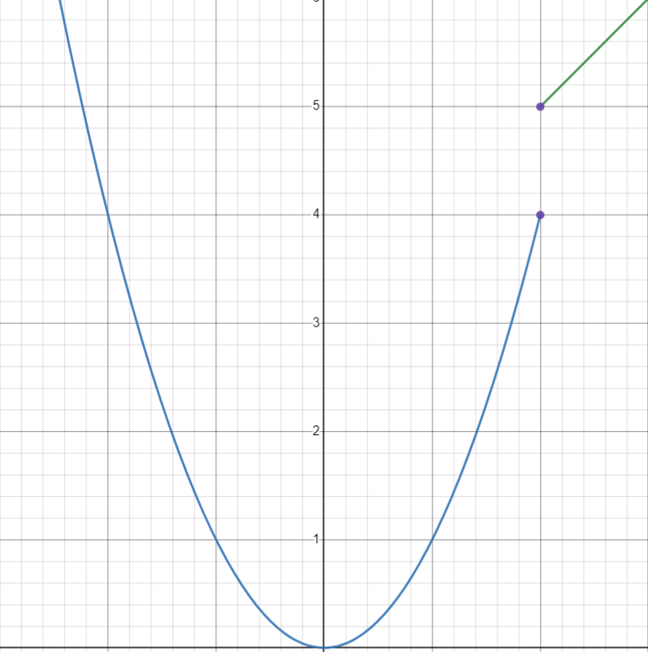
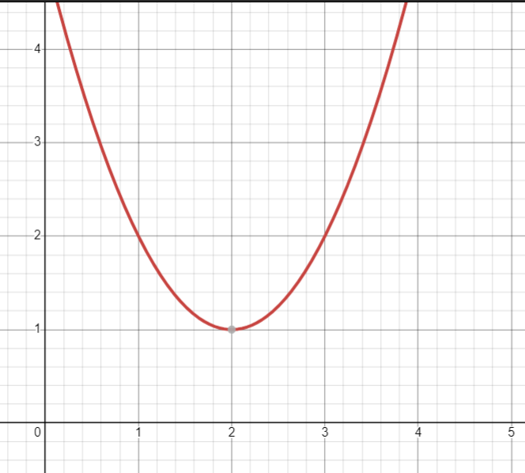

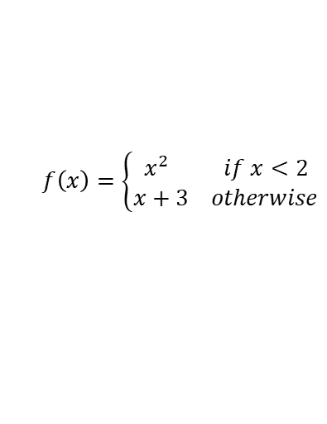
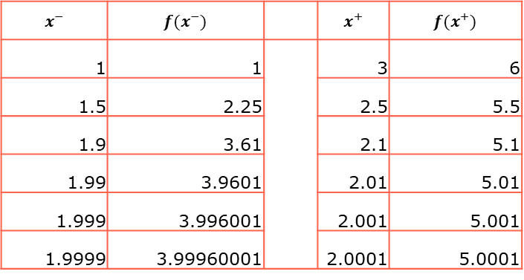
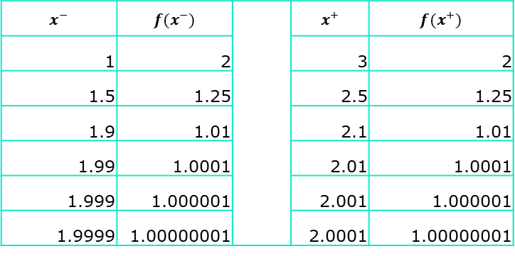
Limit of a function
$$f\left(x\right)={\left(x−2\right)}^{2}+1$$
$$f\left(x\right)=\left\{\begin{aligned}x^{2} if x<2 \\ x+3 otherwise\end{aligned}\right.$$
$$x^{−}$$ | $$f(x^{−})$$ |  | $$x^{+}$$ | $$f(x^{+})$$
1 | 2 |  | 3 | 2
1.5 | 1.25 |  | 2.5 | 1.25
1.9 | 1.01 |  | 2.1 | 1.01
1.99 | 1.0001 |  | 2.01 | 1.0001
1.999 | 1.000001 |  | 2.001 | 1.000001
1.9999 | 1.00000001 |  | 2.0001 | 1.00000001
$$x^{−}$$ | $$f(x^{−})$$ |  | $$x^{+}$$ | $$f(x^{+})$$
1 | 1 |  | 3 | 6
1.5 | 2.25 |  | 2.5 | 5.5
1.9 | 3.61 |  | 2.1 | 5.1
1.99 | 3.9601 |  | 2.01 | 5.01
1.999 | 3.996001 |  | 2.001 | 5.001
1.9999 | 3.99960001 |  | 2.0001 | 5.0001

Slide 9
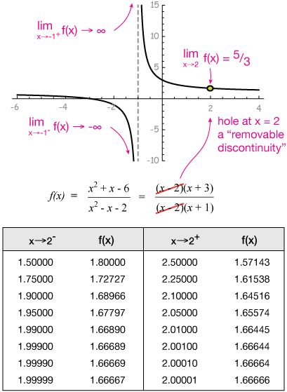
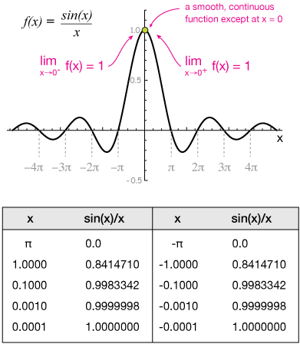
Limit of a function

Slide 10
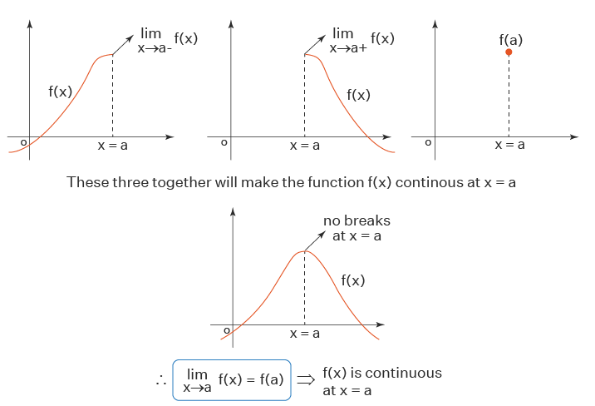
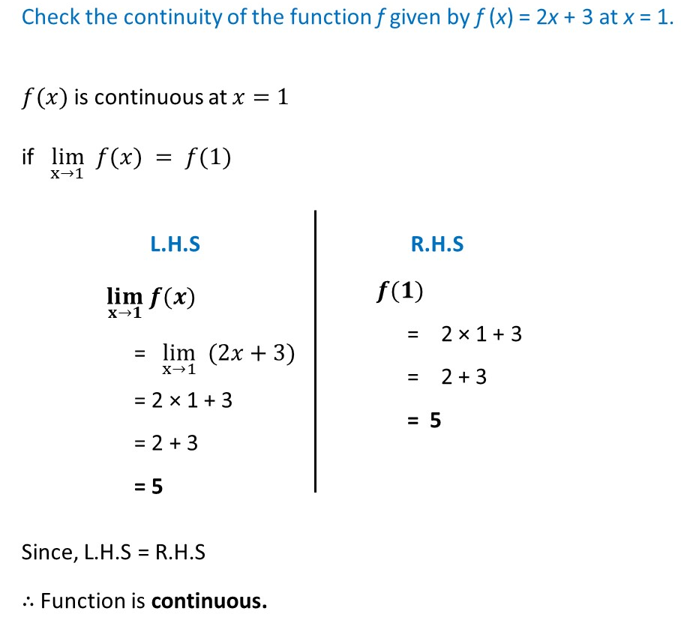
Continuity

Slide 11
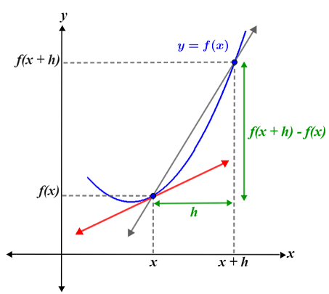
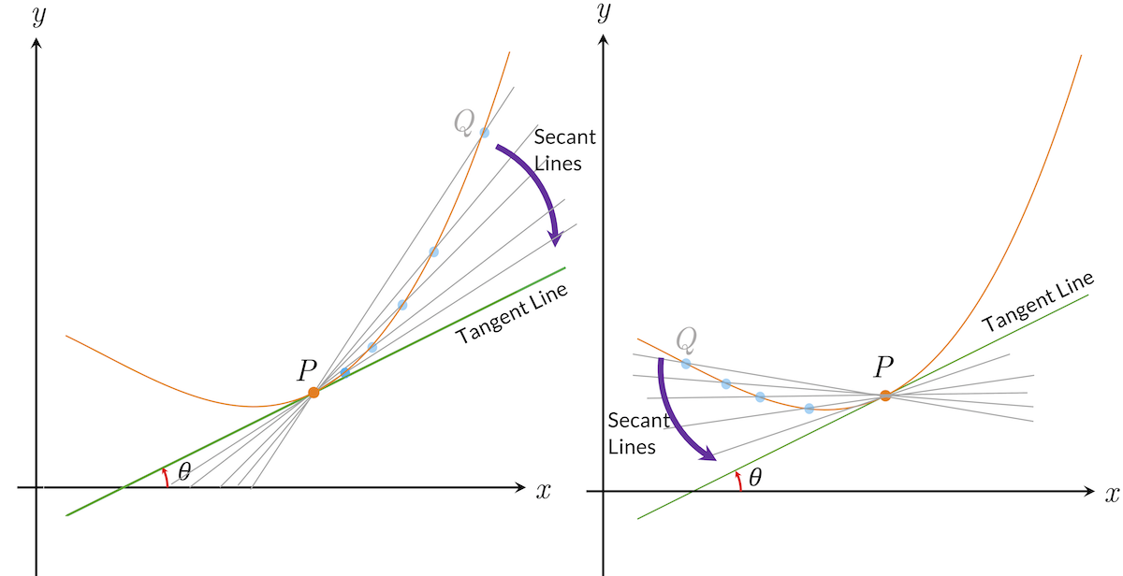
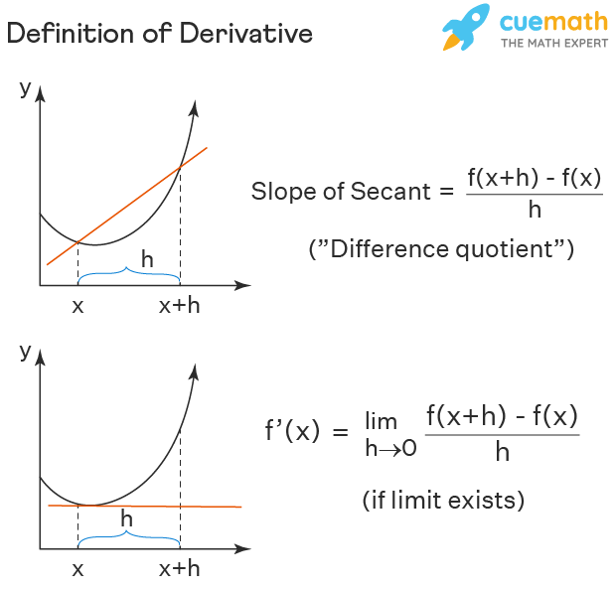
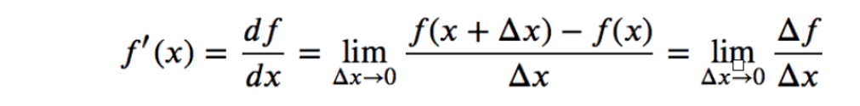
Derivative of a function

Slide 12
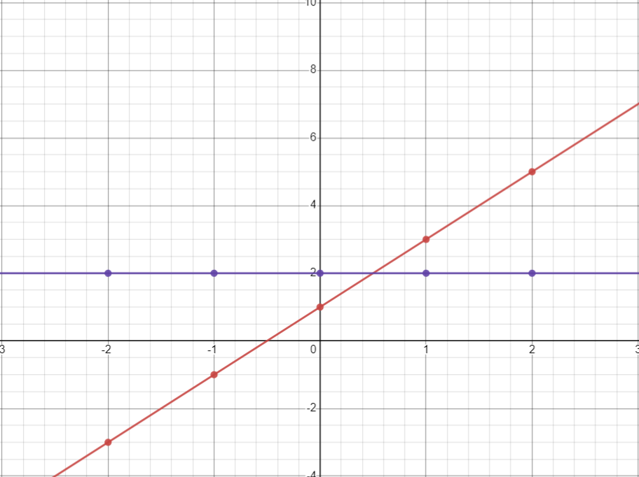
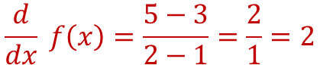
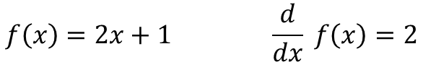
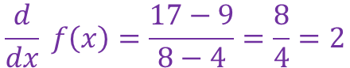


Derivative of a function
$$f\left(x\right)=2x+1 \frac{d}{dx} f\left(x\right)=2$$
x | 1 | 2 | 3 | 4 | 5 | 6 | 7 | 8
f(x) | 3 | 5 | 7 | 9 | 11 | 13 | 15 | 17
$$\frac{d}{dx} f\left(x\right)=\frac{5−3}{2−1}=\frac{2}{1}=2$$
$$\frac{d}{dx} f\left(x\right)=\frac{9−3}{4−1}=\frac{6}{3}=2$$
$$\frac{d}{dx} f\left(x\right)=\frac{7−5}{3−2}=\frac{2}{1}=2$$
$$\frac{d}{dx} f\left(x\right)=\frac{17−9}{8−4}=\frac{8}{4}=2$$

Slide 13







Derivative of a function
$$f\left(x\right)=x^{2} \frac{d}{dx} f\left(x\right)=2x$$
$$x$$ | $$0$$ | $$1$$ | $$2$$ | $$3$$ | $$4$$ | $$5$$ | $$6$$ | $$7$$
$$f(x)$$ | $$0$$ | $$1$$ | $$4$$ | $$9$$ | $$16$$ | $$25$$ | $$36$$ | $$49$$
1 3 5 7 9
$\frac{(1+3)}{2}$ = 2
$\frac{(3+5)}{2}$ = 4
$\frac{(5+7)}{2}$ = 6
$\frac{(7+9)}{2}$ = 8
$$\frac{d}{dx} f\left(x\right) at 1 2 3 4$$
$$so the derivative of f\left(x\right)=x^{2} \frac{d}{dx} f\left(x\right)=2x$$

Slide 14





$$f\left(x\right)=x^{2} \frac{d}{dx} f\left(x\right)=2x$$
$$x$$ | f(x) | $$\frac{df}{dx}=\frac{f\left(x_{0}\right)−f\left(x\right)}{x_{0}−x}$$ |  |  | $$x$$ | f(x) | $$\frac{df}{dx}=\frac{f\left(x_{0}\right)−f\left(x\right)}{x_{0}−x}$$ |  |  | $$x$$ | f(x) | $$\frac{df}{dx}=\frac{f\left(x_{0}\right)−f\left(x\right)}{x_{0}−x}$$
0 | 0 | 1 |  |  | 1 | 1 | 3 |  |  | 2 | 4 | 5
0.1 | 0.01 | 1.1 |  |  | 1.1 | 1.21 | 3.1 |  |  | 2.1 | 4.41 | 5.1
0.5 | 0.25 | 1.5 |  |  | 1.5 | 2.25 | 3.5 |  |  | 2.5 | 6.25 | 5.5
0.9 | 0.81 | 1.9 |  |  | 1.9 | 3.61 | 3.9 |  |  | 2.9 | 8.41 | 5.9
0.99 | 0.9801 | 1.99 |  |  | 1.99 | 3.9601 | 3.99 |  |  | 2.99 | 8.9401 | 5.99
0.999 | 0.998001 | 1.999 |  |  | 1.999 | 3.996001 | 3.999 |  |  | 2.999 | 8.994001 | 5.999
1 | 1 | 2 |  |  | 2 | 4 | 4 |  |  | 3 | 9 | 6
1.001 | 1.002001 | 2.001 |  |  | 2.001 | 4.004001 | 4.001 |  |  | 3.001 | 9.006001 | 6.001
1.01 | 1.0201 | 2.01 |  |  | 2.01 | 4.0401 | 4.01 |  |  | 3.01 | 9.0601 | 6.01
1.1 | 1.21 | 2.1 |  |  | 2.1 | 4.41 | 4.1 |  |  | 3.1 | 9.61 | 6.1
1.5 | 2.25 | 2.5 |  |  | 2.5 | 6.25 | 4.5 |  |  | 3.5 | 12.25 | 6.5
1.9 | 3.61 | 2.9 |  |  | 2.9 | 8.41 | 4.9 |  |  | 3.9 | 15.21 | 6.9
2 | 4 | 3 |  |  | 3 | 9 | 5 |  |  | 4 | 16 | 7
$$x_{0}^{−}$$
$$x_{0}$$
$$x_{0}^{+}$$

Slide 15






Why derivative exsist and not exsist ?
$$f\left(x\right)=1−\left|x\right| \frac{d}{dx} f\left(x\right)=\left\{\begin{aligned}−1 if x>0 \\ 1 if x<0\end{aligned}\right.$$
$$f\left(x\right)=x^{3} \frac{d}{dx} f\left(x\right)=2x^{2}$$
$$h$$ | $$\frac{f\left(x−h\right)−f(x)}{−h}$$ | $$\frac{f\left(x+h\right)−f(x)}{h}$$
1 | 1 | -1
0.1 | 1 | -1
0.01 | 1 | -1
0.001 | 1 | -1
0.0001 | 1 | -1
0.00001 | 1 | -1
0.000001 | 1 | -1
$$h$$ | $$\frac{f\left(x−h\right)−f(x)}{−h}$$ | $$\frac{f\left(x+h\right)−f(x)}{h}$$
1 | 1 | 1
0.1 | 0.1 | 0.1
0.01 | 0.01 | 0.01
0.001 | 0.001 | 0.001
0.0001 | 0.0001 | 0.0001
0.00001 | 0.00001 | 0.00001
0.000001 | 0.000001 | 0.000001

Slide 16






Function of Several Real Variables
A real-valued function of n real variables is a function that takes as input n real numbers, commonly represented by the variables $x1, x2, …, xn$ for producing another real number, the value of the function, commonly denoted $f(x1, x2, …, xn).$
$$y=f(x_{1},x_{2})$$
$$y=f\left(x_{1},x_{2}, x_{3}\right)$$
.
.
.
$$y=f(x_{1},x_{2}, x_{3}, ……,x_{n})$$

Slide 17








Partial Derivatives
$$z=xy^{2}−y sin⁡(x)$$
$$\frac{∂z}{∂x}=y^{2} −y\cos\left(x\right)$$
$$\frac{∂y}{∂x}=2xy −sin⁡(x)$$
$\frac{∂z}{∂s}=\frac{∂z}{∂x}$ $\frac{∂x}{∂s}$ + $\frac{∂z}{∂y}$ $\frac{∂y}{∂s}$
$\frac{∂z}{∂t}=\frac{∂z}{∂x}$ $\frac{∂x}{∂t}$ + $\frac{∂z}{∂y}$ $\frac{∂y}{∂t}$

Slide 18



Partial Derivatives ! Why ?
$z=f\left(x,y\right)=2x+3y$
$$\frac{∂z}{∂x}=2 \frac{∂z}{∂y}=3$$
Isolating Independent Effects: When a function depends on multiple variables, partial derivatives allow us to isolate the effect of changing one variable while holding the others constant. This is crucial for understanding how different factors interact and contribute to the overall behavior of the function
$$f$$ |  | y
 |  | 0 | 1 | 2 | 3 | 4
x | 0 | 0 | 3 | 6 | 9 | 12
 | 1 | 2 | 5 | 8 | 11 | 14
 | 2 | 4 | 7 | 10 | 13 | 16
 | 3 | 6 | 9 | 12 | 15 | 18
 | 4 | 8 | 11 | 14 | 17 | 20
$$f\left(1,0\right)=2 → f\left(3,4\right)=18$$
$$Δf=18−2=16$$
$$Δx=2 Δy=4$$
$$Δf=Δx . 2 +Δy . 3=16$$
$$Δf=Δx \frac{∂z}{∂x}+Δy\frac{∂z}{∂y}=16$$
Local Sensitivity Analysis: Partial derivatives measure the instantaneous rate of change of a function with respect to each variable at a specific point. This provides insights into how sensitive the function is to small changes in each variable locally.

Slide 19








Derivatives and Optimization
Here $θ_{p}<θ_{Q}⇔tan{(θ}_{P})<\tan{(θ_{Q})};$we know,
$\frac{dy}{dx} at P=tan{(θ}_{P})$ ; $\frac{dy}{dx} at Q=tan{(θ}_{Q})$
What is the angle of tangent at M ?
$$θ_{m}=0⇒\tan{(θ_{m})=0}⇒\frac{dy}{dx}=0 at M$$
$$Derivative at a point x_{c }is 0⇒x_{c} is an extremum point$$
$$which is a maximum or minimum, then it can be used for$$
$$optimization$$
$$Q$$
$$P$$
$$M$$
$$θ_{Q}$$
$$θ_{P}$$
$$O$$

Slide 20





Derivatives and Optimization
$$Gradient of a function$$
Find the extrema of $f\left(x,y\right)=x^{2}+2y^{2} −4(x+y)$
Gradient:
$$∇f = \left(2x − 4, 4y − 4\right)$$
2. Critical point: $(2, 1)$
$$To find optimal points of a function f(x_{0}, x_{1}, x_{2},….. x_{n}\text{)}:$$
Calculate $∇f$
Find $x_{0}, x_{1},….. x_{n}$ where $∇f(x_{0}, x_{1}, x_{2},….. x_{n}$) = 0

Slide 21







Error function and Surface
Linear Regression
Perceptron
$$\hat{y}=mx+b$$
$$\hat{y}=\frac{1}{1+e^{(−w_{1}x_{1}−θ}}$$
$$J= \sum{{\left(y −\hat{y}\right)}^{2}=\sum{{\left(y −mx −b\right)}^{2}=J(m,b) }}$$
$$J= \sum{{\left(y −\hat{y}\right)}^{2}=\sum{{\left(y −\frac{1}{1+e^{(−w_{1}x_{1}−θ)}}\right)}^{2}=J(w_{1},θ) }}$$

Slide 22





Dr. Shailesh Sivan
+91 8907230664
shaileshsivan@cusat.ac.in
https://shaileshsivan.info

Slide 23


